Slide 1
CO2: Deep Learning AbschlussProjekt
Baumgartner David
Pirklbauer Georg

Slide 2
Datensätze
Data.zip
8k von der UrbanSound Homepage
5% Test
Validation
85 / 15 Validation Split
Random Shuffle
24 Durchläufe mit
NN
CNN
LSTM
GRU
RNN
Bestes Ergebnis im Test:
Neural Net auf dem 8k Datensatz (93% Test Accuracy)
CNN auf dem kleineren Datensatz (92% Test Accuracy)
Schlectestes Ergebnis im Test:
RNN auf dem 8k Datensatz (62% Test Accuracy)
Notes:
Bestes ergebnis nach mittlerer Accuracy

Slide 3
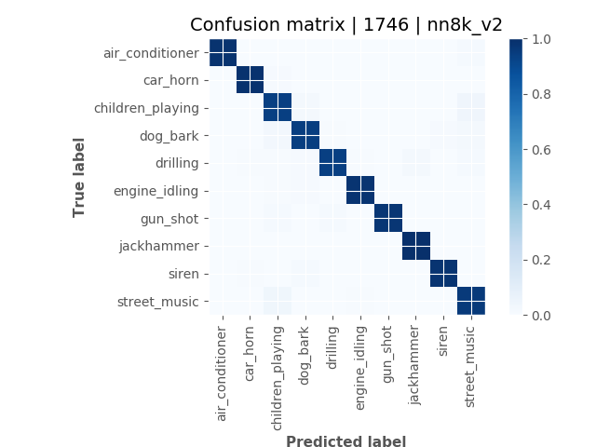
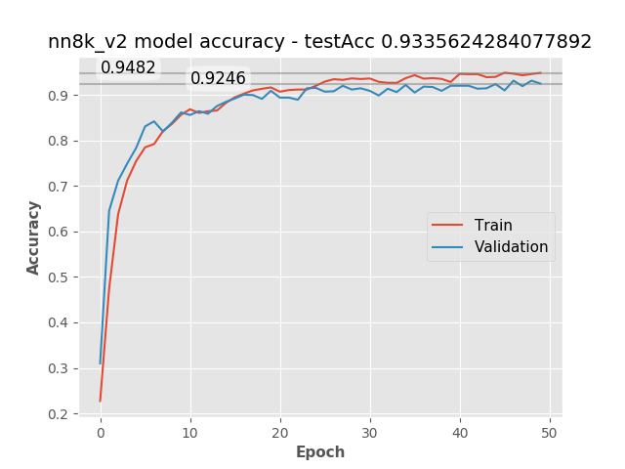
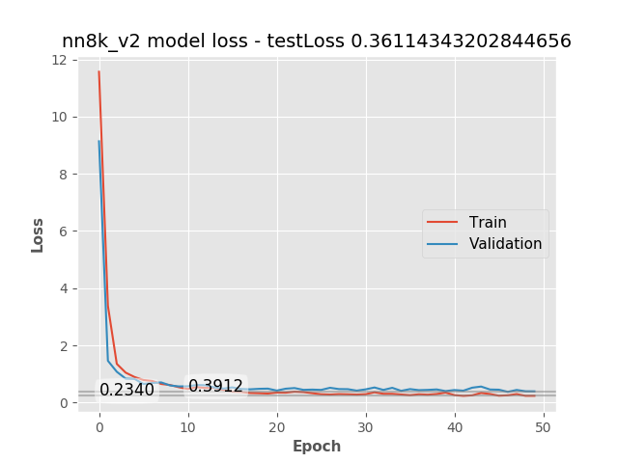
Bestes Ergebnis (8K) MLp

Slide 4
Parameter
Preprocessing
Mfcc, Chroma_stft, mel_spectrogram spectral_contrast, tonnetz
Konkateniert in einem Vektor
Input für „normales“ MLP
Activation
ReLU -> ReLU -> Softmax
Dropouts
25% -> 20%
Adam Optimizer

Slide 5
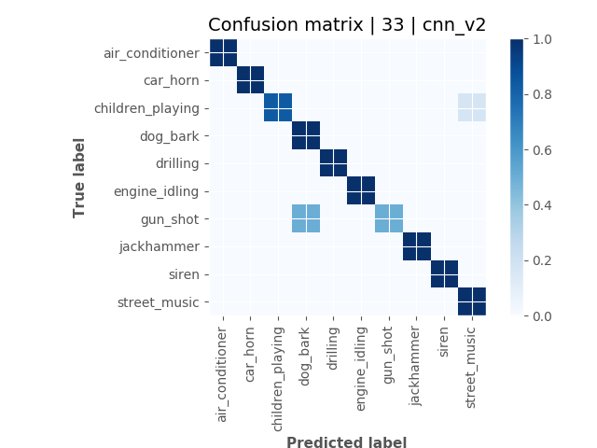
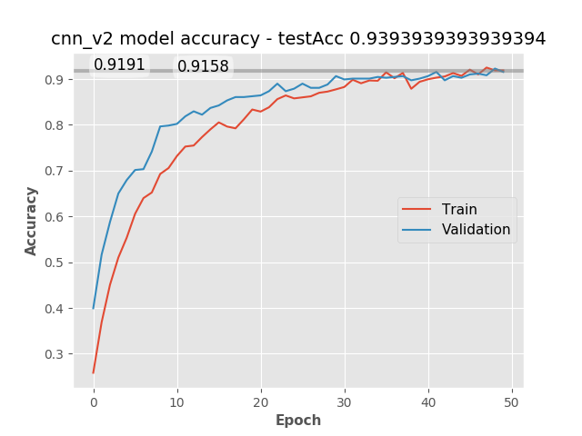
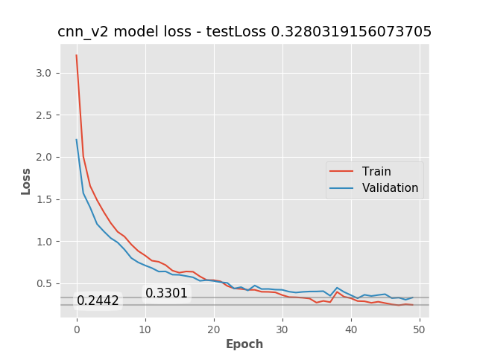
Bestes Ergebnis CNN

Slide 6
Parameter
Preprocessing
Mfcc, Chroma_stft, mel_spectrogram spectral_contrast, tonnetz
Konkateniert in einem Vektor
Conv1d x2
Repräsentation ursprünglich für NN gedacht
Activation
ReLU x3 -> Softmax
Dropouts
25% -> 50%
Adam Optimizer

Slide 10
model | source | version | AccTrain | AccVal | AccTest | avg_acc | LossTrain | LossVal | LossTest | avg_loss
nn | 8k | 2 | 0.9482 | 0.9246 | 0.9335 | 0.935433 | 0.234 | 0.3912 | 0.3611 | 0.328767
nn | 8k | 1 | 0.9685 | 0.9179 | 0.9083 | 0.931567 | 0.0895 | 0.331 | 0.3651 | 0.261867
lstm | 8k | 3 | 0.9635 | 0.9083 | 0.9102 | 0.927333 | 0.1032 | 0.3171 | 0.3225 | 0.2476
gru | 8k | 2 | 0.9542 | 0.9133 | 0.9099 | 0.9258 | 0.1286 | 0.3097 | 0.3114 | 0.2499
cnn |  | 2 | 0.9191 | 0.9158 | 0.9393 | 0.924733 | 0.2442 | 0.3301 | 0.328 | 0.300767
cnn | 8k | 2 | 0.92 | 0.92 | 0.9226 | 0.920867 | 0.2303 | 0.3485 | 0.2759 | 0.2849
nn |  | 1 | 0.9735 | 0.8993 | 0.8787 | 0.917167 | 0.0725 | 0.3586 | 0.4484 | 0.293167
lstm |  | 3 | 0.9847 | 0.8884 | 0.8636 | 0.912233 | 0.0455 | 0.5168 | 0.5444 | 0.3689
gru |  | 2 | 0.9792 | 0.8827 | 0.8585 | 0.9068 | 0.0597 | 0.5745 | 0.7231 | 0.452433
lstm |  | 1 | 0.9675 | 0.8671 | 0.8838 | 0.906133 | 0.1027 | 0.5403 | 0.3518 | 0.3316
lstm |  | 2 | 0.9754 | 0.8767 | 0.8585 | 0.903533 | 0.0704 | 0.519 | 0.6459 | 0.411767
lstm | 8k | 2 | 0.9449 | 0.8789 | 0.881 | 0.9016 | 0.1542 | 0.4126 | 0.4128 | 0.326533
gru |  | 1 | 0.9598 | 0.8626 | 0.8686 | 0.897 | 0.1205 | 0.5145 | 0.4117 | 0.3489
nn |  | 2 | 0.9372 | 0.8974 | 0.8484 | 0.894333 | 0.3988 | 0.8027 | 0.363 | 0.5215
lstm | 8k | 1 | 0.9199 | 0.8646 | 0.8708 | 0.8851 | 0.2283 | 0.4267 | 0.4036 | 0.352867
cnn | 8k | 1 | 0.8713 | 0.8747 | 0.8733 | 0.8731 | 0.365 | 0.3968 | 0.3777 | 0.379833
cnn |  | 3 | 0.9133 | 0.8488 | 0.8484 | 0.870167 | 0.24 | 0.5466 | 0.6034 | 0.463333
gru | 8k | 1 | 0.8903 | 0.8589 | 0.8588 | 0.869333 | 0.3183 | 0.444 | 0.4294 | 0.397233
cnn | 8k | 3 | 0.8958 | 0.8524 | 0.8471 | 0.8651 | 0.3035 | 0.4647 | 0.4912 | 0.4198
cnn |  | 1 | 0.8936 | 0.8368 | 0.8232 | 0.8512 | 0.298 | 0.4965 | 0.4798 | 0.424767
rnn |  | 2 | 0.8486 | 0.7696 | 0.7777 | 0.798633 | 0.4368 | 0.7762 | 0.804 | 0.672333
rnn |  | 1 | 0.7665 | 0.6892 | 0.803 | 0.7529 | 0.6775 | 0.9443 | 0.5678 | 0.729867
rnn | 8k | 2 | 0.7721 | 0.7191 | 0.7242 | 0.738467 | 0.6601 | 0.8237 | 0.816 | 0.7666
rnn | 8k | 1 | 0.6597 | 0.6183 | 0.6276 | 0.6352 | 1.0053 | 1.1113 | 1.095 | 1.070533

Slide 11
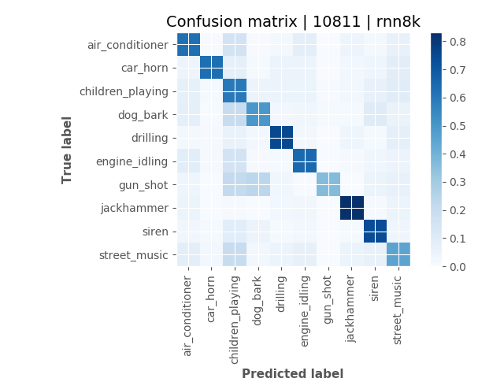
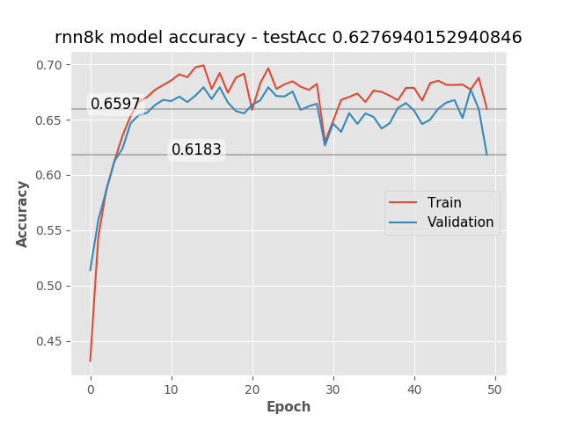
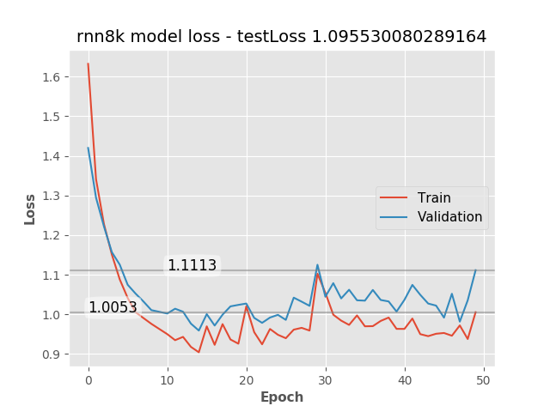
ScHlecHtestes Ergebnis RNN (8K)

Slide 12
Parameter
Preprocessing
Mfcc
Input für „normales“ LSTM
Activation
Softmax
Adam Optimizer

